Slide 1

ZOMATO RESTAURANT ANALYSIS
By
Suyesh Pandit

Slide 2
About Zomato
Founded: By Deepinder Goyal and Pankaj Chaddah in India in year 2008.
Global Presence: It is now actively used in 24+ countries, with a strong focus on India, UAE, and Australia.
Sustainability Efforts: Initiatives to reduce plastic waste and promote eco-friendly practices.
Recent Developments: Expansion into grocery delivery and cloud kitchens, adapting to market trends has now increased chances of employment and engagement of the app and it’s services.

Slide 3
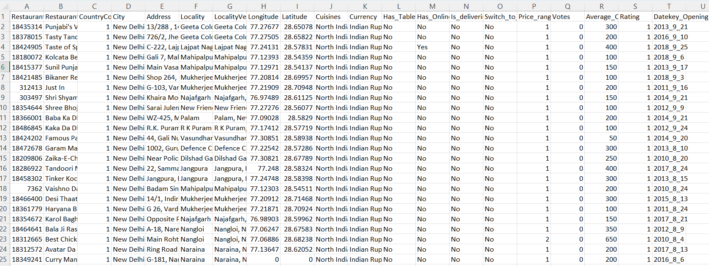
Problem Statement
I am a assigned as consultant data analyst by zomato where the team is looking for expansion and opening restaurants. My task is to come up with strategies/suggestions about opening newer restaurants.

Slide 4
DATASET OVERVIEW
Has_Online_delivery: Indicates whether the restaurant offers online delivery (Yes/No).
Is_delivering_now: Indicates whether the restaurant is currently delivering (Yes/No).
Switch_to_order_menu: Indicates whether users can switch to the order menu (Yes/No).
Price_range: A numeric value indicating the price range category of the restaurant.
Votes: The number of votes or ratings/(feedback) received by the restaurant.
Average_Cost_for_two: The average cost for two people dining at the restaurant.
Rating: The overall rating of the restaurant is based on user reviews.
Datekey_opening: The date when the restaurant was opened.
Average_cost_for_two(INR)- This show the average cost for two in indian currency.
Restaurant ID: Unique identifier for each restaurant.
Restaurant Name: The name of the restaurant.
CountryCode: Country code of the location where the restaurant is situated.
City: The city where the restaurant is located.
Address: The specific address of the restaurant.
Locality: The locality or neighbourhood where the restaurant is situated.
Locality Verbose: Detailed information about the locality.
Longitude: The geographical longitude coordinate of the restaurant.
Latitude: The geographical latitude coordinate of the restaurant.
Cuisines: The type of cuisine offered by the restaurant.
Currency: The currency used for transactions in the restaurant.
Has_Table_booking: Indicates whether the restaurant has a table booking option (Yes/No).

Slide 5
Operational Strategy
Data cleaning involved removing blank values (representing 5% of the dataset) and eliminating duplicates to ensure data accuracy
Data enrichment improved readability by using VLOOKUP to fill in missing information, such as dates, price references, conversion units, and country names..
Descriptive analysis was conducted using pivot tables and charts to visualize trends across ratings, votes, cuisines, and yearly openings, identifying key regions for expansion.
Customer preference analysis analysis explored cuisine popularity by country and region, based on average ratings and votes.
Restaurant performance was assessed by evaluating the average cost for two and ratings.
Finally, dynamic dashboards with pivot charts and tables were created to present the findings in an engaging and easily understandable format.

Slide 6
Country wise Restaurant Count
The analysis reveals a total of 9,551 restaurants, with India leading at 8,652, followed by the USA (434), the UK (80), South Africa (60) and Brazil (60).
This indicates that countries with a high concentration of restaurants are likely saturated, while markets with fewer establishments, such as Canada, present significant opportunities for expansion.

Slide 7
Yearly Restaurant Openings
The trend reveals a peak in restaurant openings in 2011, with 1,098 new establishments.
Following a sharp decline in 2012, the market experienced fluctuating growth, eventually stabilizing with consistent increases starting in 2015.
A significant spike in 2017 suggests an ongoing upward trajectory.
This pattern reflects sustained demand and indicates a positive market outlook in the years ahead.

Slide 8
Average Votes Country wise
The highest number of votes is recorded for Indonesia at 772, while Brazil has the lowest with just 20 votes.
Despite having the highest restaurant count, countries like India show relatively low average votes of 137.
This data analysis reveals that the number of votes does not correlate directly with the restaurant count, indicating that higher restaurant numbers do not necessarily lead to higher voter engagement.

Slide 9
Expenditure
The average cost for two in the recommended countries ranges from Rs 139 to Rs 13,192.
This helps narrow down our target cities by focusing on states that have high votes, high ratings, and a favorable average cost for two.
The preferred states in the suggested countries are:
Turkey with an average cost of Rs 206.46.
Singapore with an average cost of Rs 13,192.34.
New Zealand with an average cost of Rs 2,464.41 and a rating of 4.3 making it the most preferred due to its potential for generating maximum revenue.
Philippines with both, the highest rating and high cost for two.

Slide 10
Cuisines
In the target cities, the most popular and highly rated cuisines are as follows:
USA: American, BBQ
UK: American, Burger, Grill
South Africa: French, European, Tapas
Philippines: Mexican, Japanese, Indian
India: Italian, Mughlai, Continental
The analysis shows that popular cuisines differ by location, so focusing on local favourites with high ratings will attract a larger customer base and drive business success.

Slide 11
Online Services
Some countries offer online table booking and online delivery systems, which can be highly beneficial for establishing a market presence. These services can also be implemented in our target countries if they are not already available, helping to enhance customer convenience and drive business growth.

Slide 12
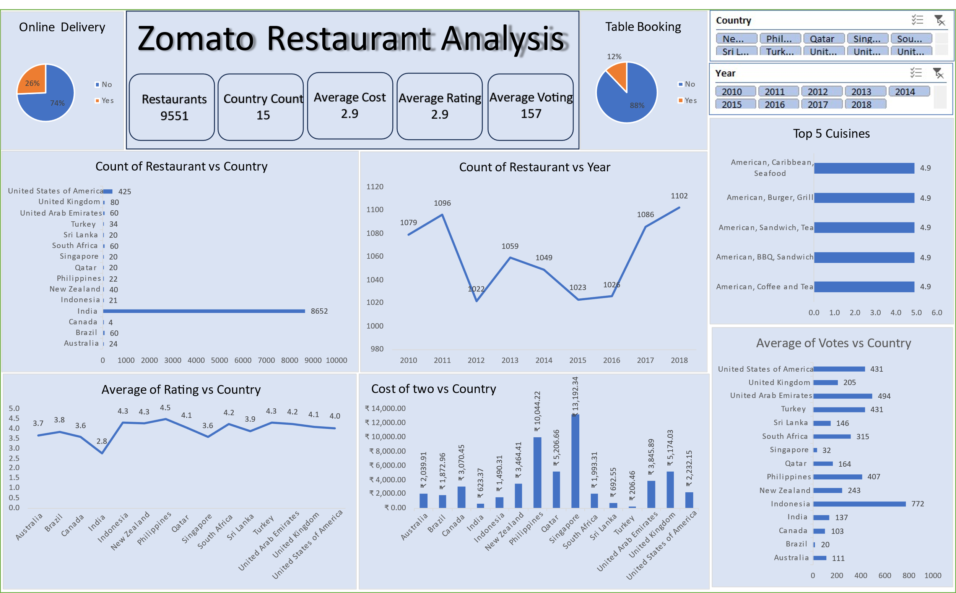

Slide 13
Recommendations
I recommend expanding restaurant operations in Sri Lanka, Singapore, Canada, and Australia due to their relatively low restaurant count and average ratings ranging between 3.5 and 4.0. These factors present strong opportunities for growth and market penetration in these countries.
Among these countries, the most suitable cities for opening restaurants are:
Sri Lanka: Colombo
Singapore: Singapore
Canada: Vineland Station
Australia: Palm Cove, Tanunda, East Ballina
The popular local cuisines to focus on for new restaurants in these countries are:
Singapore: Italian and Bakery items are highly favored.
Canada: Italian and Pizza are the most popular choices.
Australia: Pizza and Mediterranean cuisine dominate.
Sri Lanka: American and Fast Food are the top preferences.
By aligning the restaurant menu with these local favorites, while maintaining high quality and consistency, restaurants can enhance customer satisfaction and improve ratings.

Slide 14
Conclusion
Customer Response: Analyzed customer ratings, votes, and preferences to understand their impact on restaurant performance and cuisine selection.
New Market Penetration: Identified competitors and pinpointed restaurants with lower ratings, highlighting potential opportunities for market entry.
Pattern Analysis: The relationship between high-rated restaurants and their cuisines reveals clear insights into pricing strategies and preferred price brackets.

Slide 15
Thank you

